Slide 1

Practical 3
Information Gathering using Shodan
Ethnical Hacking
Diploma in ISF Year 3 (2020/21), Semester 5
Notes:
Left-hand Bar – Replace FSP by your module code and X by the lecture number.
Replace Lecture Title
Replace < Module Name >
Replace Year and Semester if necessary

Slide 2
Introduction
Shodan is a search engine for hackers, and have even called it "the world's most dangerous search engine".
Developed by John Matherly in 2009, and unlike other search engines, it looks for specific information that can be invaluable to hackers.
Shodan can find us webcams, traffic signals, video projectors, routers, home heating systems, and SCADA systems that, for instance, control nuclear power plants and electrical grids. If it has a web interface, Shodan can find it!

Slide 3
Shodan pulls service banners from servers and devices on the web, mostly port 80, but also ports 21 (ftp), 22 (SSH), 23 (telnet), 161 (SNMP), and 5060 (SIP).
These banners are what the web servers and devices "advertise" to the world as to who they are. By searching these web banners, we can find the log-in interface for nearly every web-enabled device on planet earth.

Slide 4
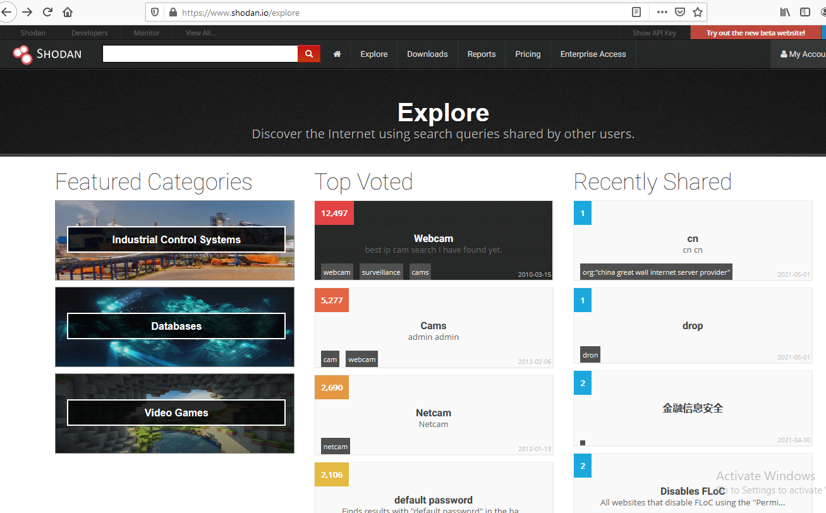
Browsing results of searches shared by Shodan’s users

Slide 5
Learning Objective
At the end of this practical, you will be able to make use shodan to collect information on public facing devices.

Slide 6
Contents
Tasks
Task 1 - Create a Shodan Account
Task 2 - Search for routers using Shodan’s Web Interface
Task 3 - Using Shodan CLI in Kali Linux
Task 4 - Using Shodan with Metasploit
Challenges

Slide 7
Important Instructions
Do this exercise on your own notebook.
Connect your machine to the lab. Wireless network. If the practical did not work, connect to your phone hotspot.
Open Kali Linux in another player.
The network setting set to NAT. Check the IP and note it down after you login the OS.
If any one of the VMs appeared to be slow, you need to increase the memory and number of processor of the respective VM.

Slide 8
Create a Shodan Account

Slide 9
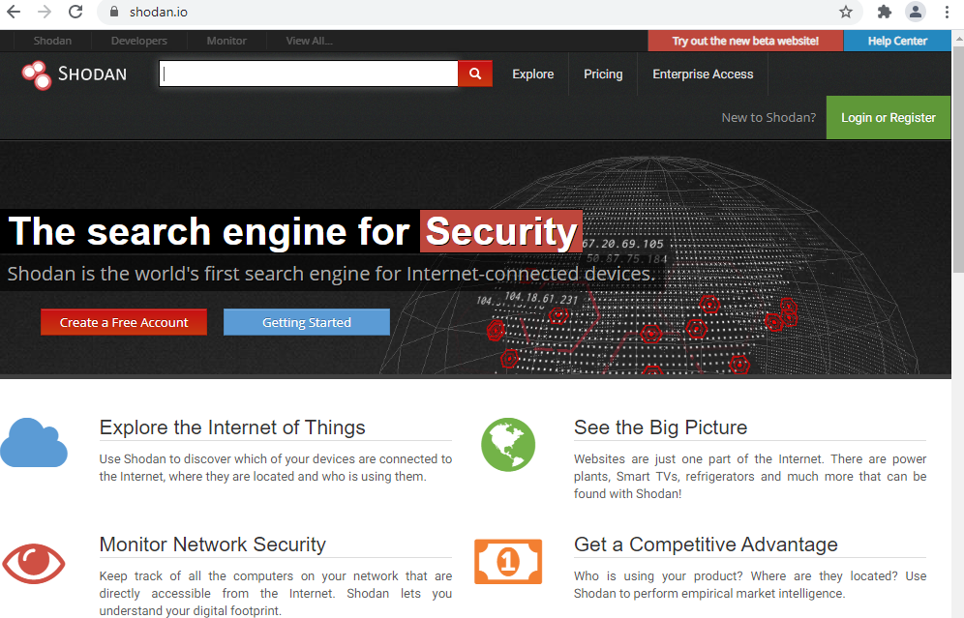

Slide 10
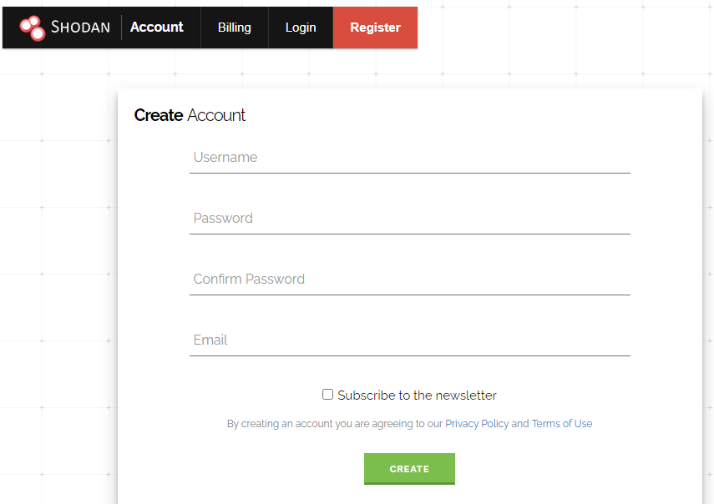
Register for a Shodan account

Slide 11
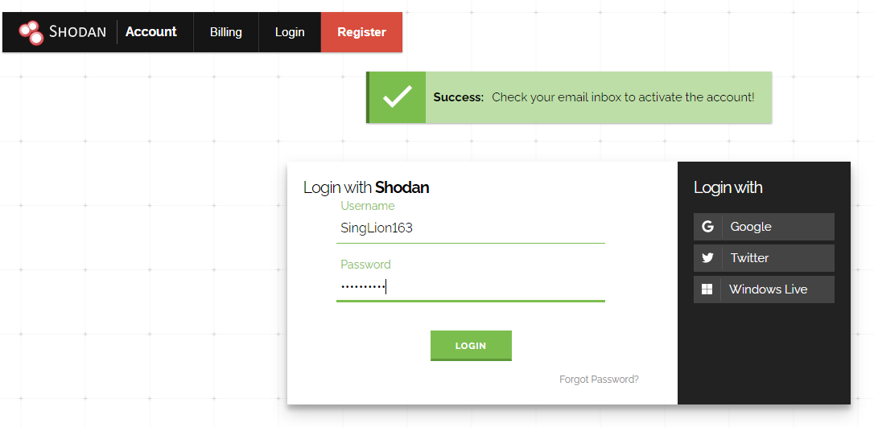
Account activation

Slide 12
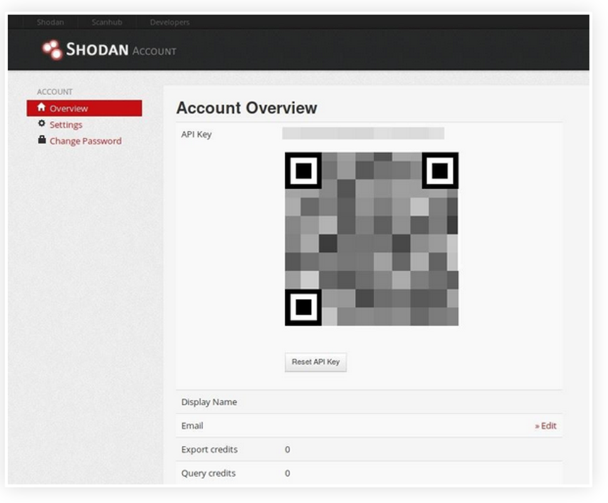

Check out the API Key assigned to your account

Slide 13
Search for routers using Shodan’s Web Interface

Slide 14

Try to locate public facing Linksys routers in Singapore that is vulnerable to attack…

Slide 15
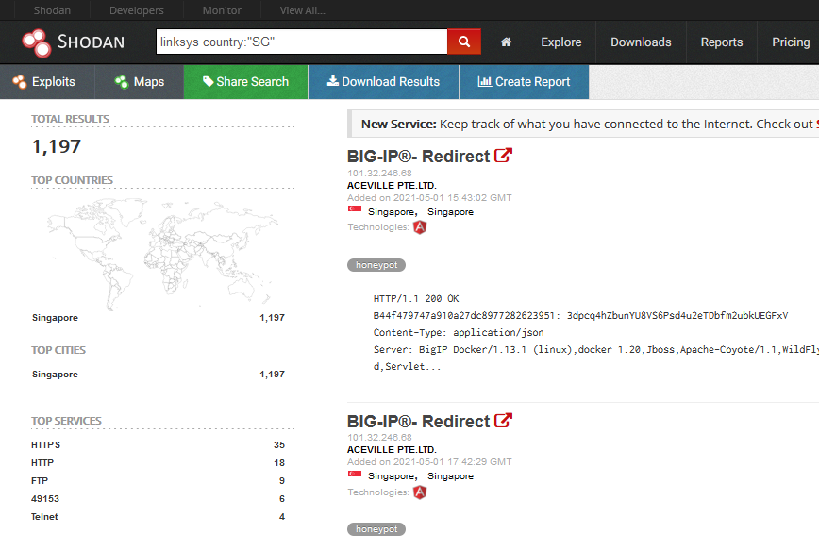
Two pages of findings will be returned each search.

Slide 16

After displaying two pages of search results, you will see such message… Need subscription to obtain more results You may register more accounts to try… I have three shodan and I rotate in using them!

Slide 17
Note: You may not found what I have found and if that is the case, just point to the different IP in the subsequent slides using your browser…

Slide 18
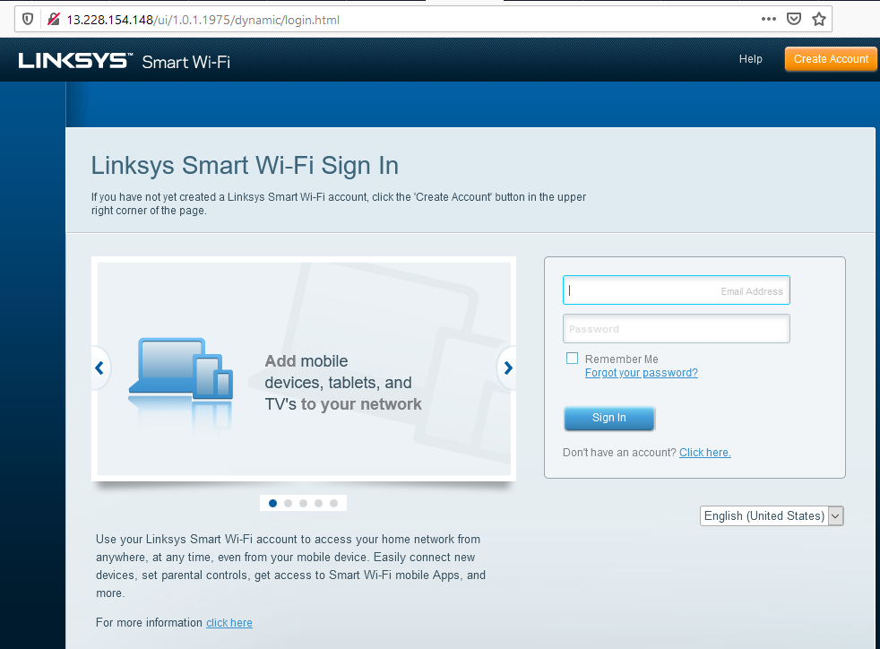
Try this address… http://13.228.154.148

Slide 19
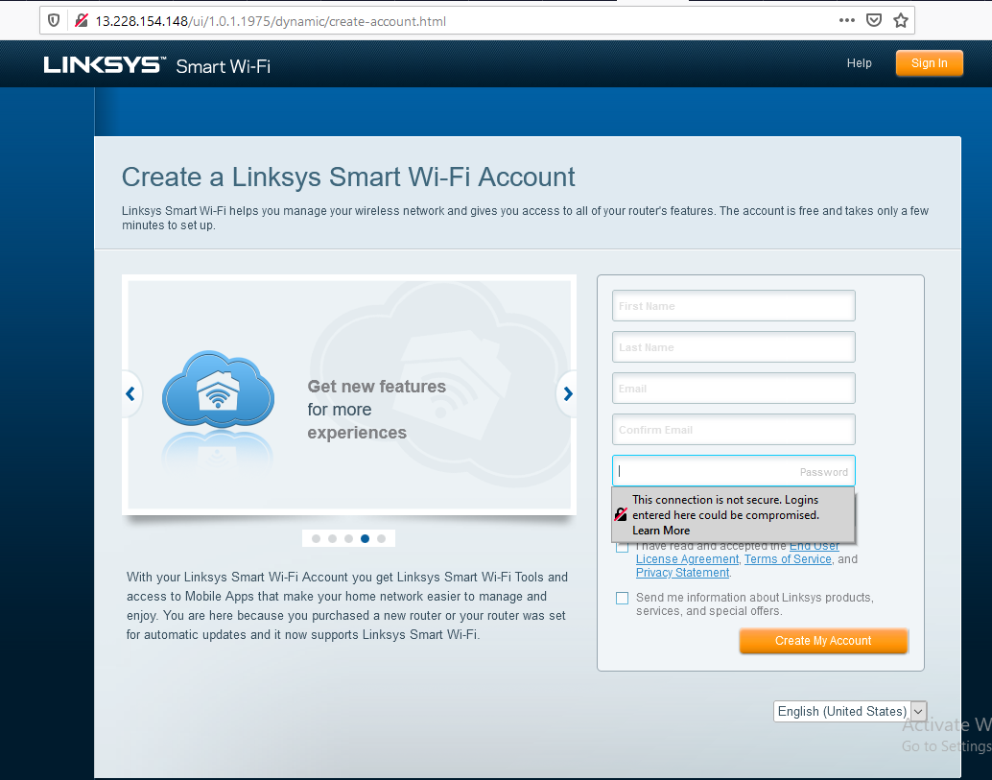
Just help yourself ! Do not attempt to change …

Slide 20
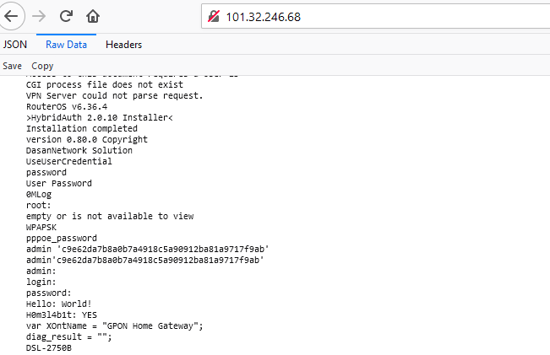
Try this IP address, http://101.32.246.68/ what device is it ….

Slide 21
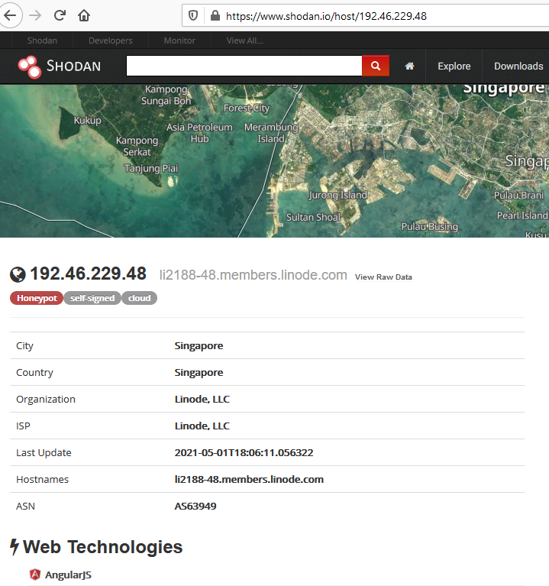
Honeyport?

Slide 22
Using Shodan CLI in Kali Linux

Slide 23
The Shodan command-line interface (CLI) is packaged with the official Python library for Shodan, which means if you're running the latest version of the library you already have access to the CLI.

Slide 24
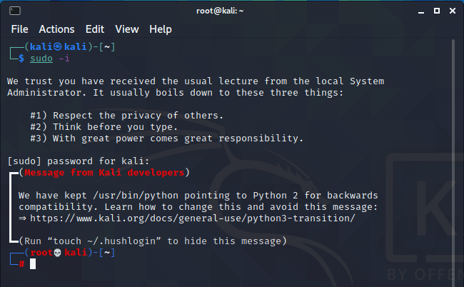
Start a terminal …

Slide 25



Shodan is included in Kali Linux 2021.1…

Slide 26
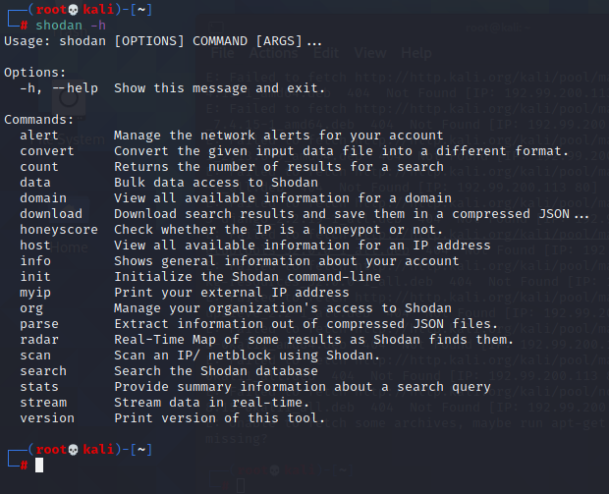
List Shodan commands and options #shodan –h

Slide 27
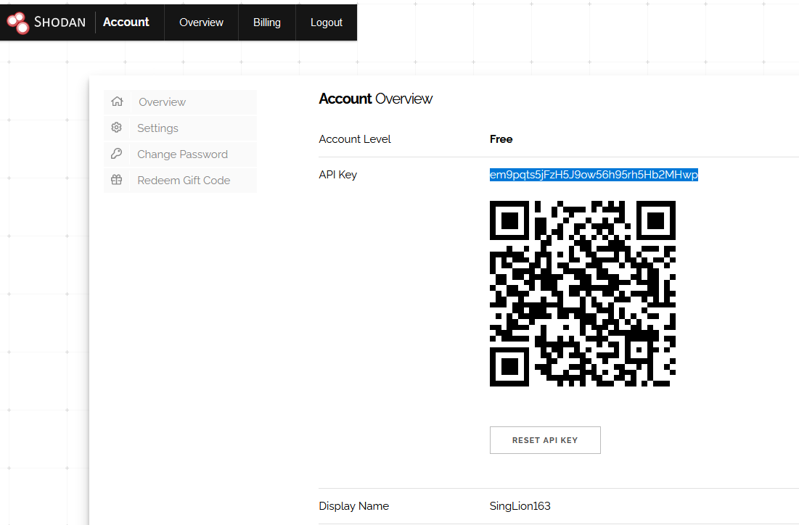
Select and copy your API Key into Clipboard..
Coy key here
Can be rest

Slide 28
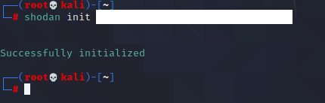
Issue the command line to initiate shodan with your API Key

Slide 29



Count the number of Linksys devices found by Shodan

Slide 30
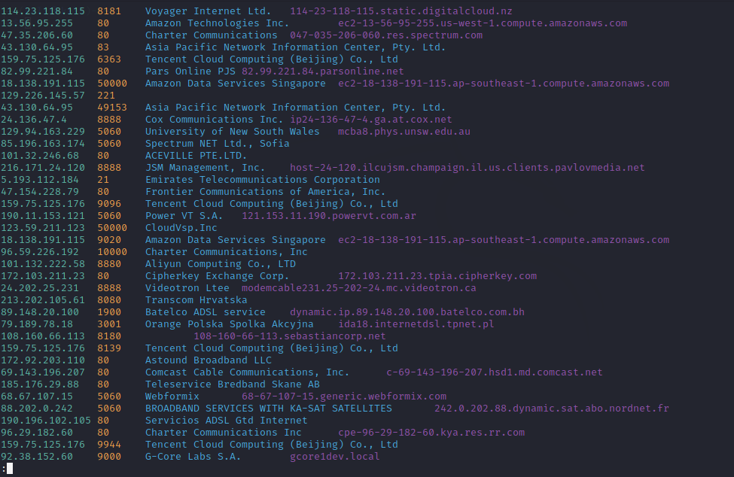
The list will be displayed in a “vi” editor. You need to press [sp bar] to view the rest of records or key “q” to editor

Slide 31
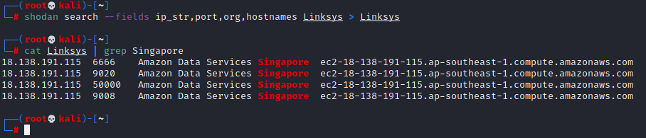
One can redirect the output to a file … and list the records using the “cat” and “grep”commands …

Slide 32
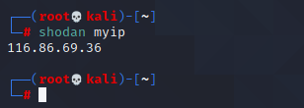
One can obtain the IP Address of their public facing router

Slide 33
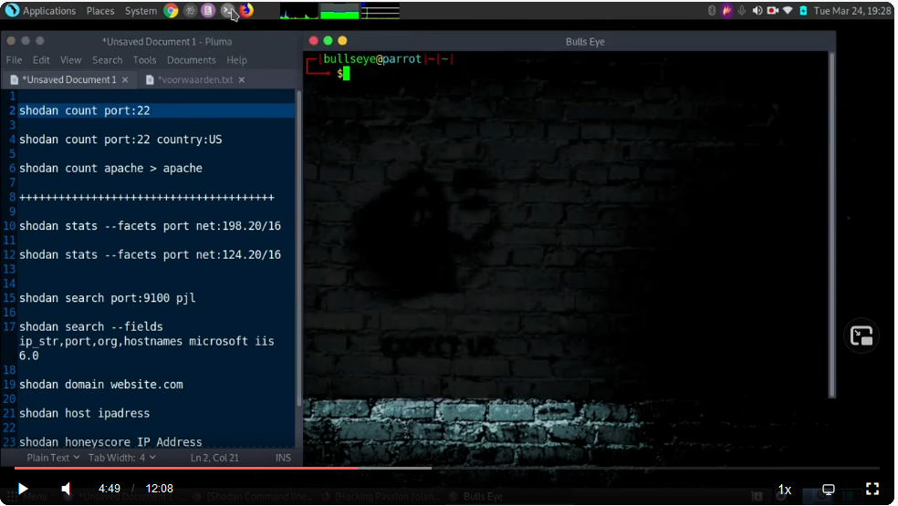
Learn more Shodan CLI commands… View from 4.49 minutes onwards
https://cdn.lbryplayer.xyz/api/v4/streams/free/shodan-command-line-a-step-by-step/04b7f18d0c10795a682a1f24052c14cdcc01e596/fa223d

Slide 34
Using Shodan with Metasploit

Slide 35
Metasploit Framework has a capability to integrate with Shodan to fire search queries right from msfconsole.
It allows the users to set the number of search pages returned without exhausting your daily searches so quickly.

Slide 36
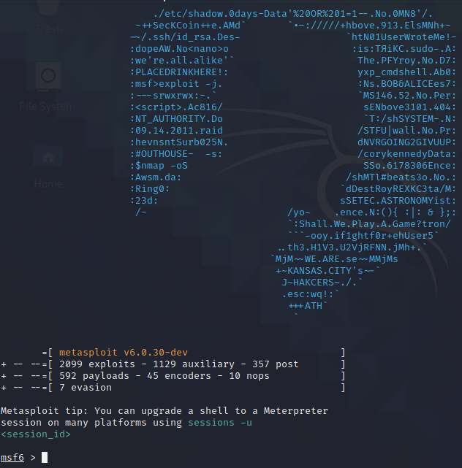
Start metasploit framework in Kali Linux …

Slide 37
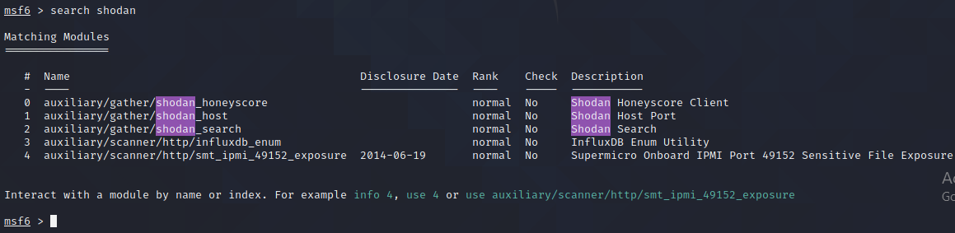
Looks for Shodan modules

Slide 38
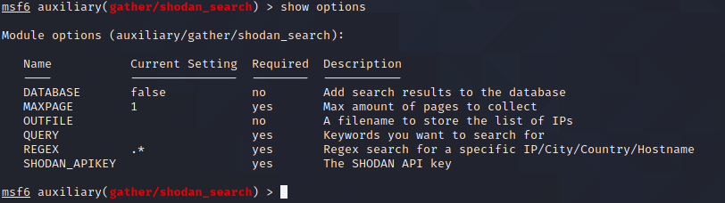
Use shodan_search module

Slide 39
Set API key and Query

Slide 40
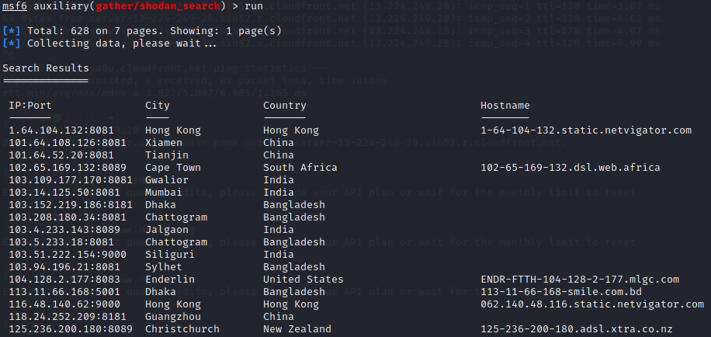
Run the auxiliary code and view the output

Slide 41
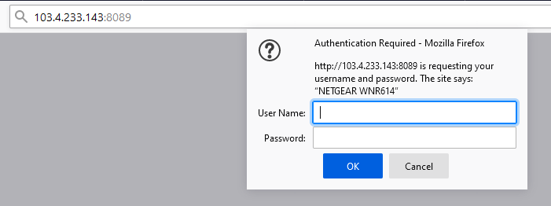
Select IP and port and paste into URL of your browser, enter “admin:password”

Slide 42
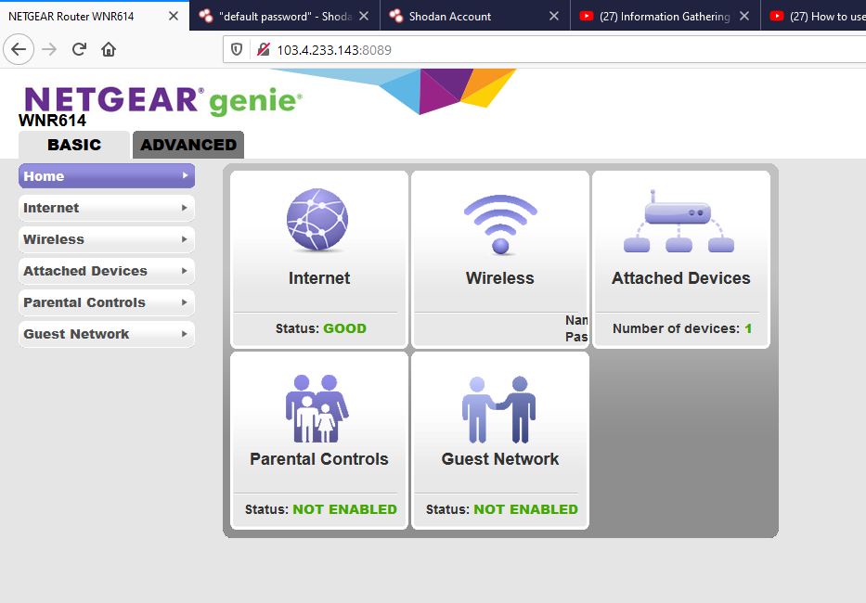
Woolah! Please do not alter any parameters…

Slide 43
Challenges

Slide 44

Challenge 3.1
Complete the following search and find one public webcam that you can exploit.
Document your finding in a Powerpoint file and submit to your class week 3 channel in a “webcam” folder
Name your file as Cha3.1-your full name(Avoid using name NOT on your student card).
Complete this challenge before week 4

Slide 45
Challenge 3.2
Research to find out if your home router has been crawled and listed in the Shodan database.
Suggest how you can prevent you can remove your device from the Shodan IoT search engine
https://www.comparitech.com/blog/vpn-privacy/remove-device-shodan/
Summarized your finding in a Powerpoint file and submit to your class week 3 channel in a “Remove” folder
Name your file as Cha3.2-your full name(Avoid using name NOT on your student card).
Complete this challenge before week 4

Slide 46
Challenge 3.3
Shodan can also be integrated with maltego to search for devices on the network.
Follow the guide in the link below to start your exploration…
https://www.exploit-db.com/docs/english/33859-searching-shodan-for-fun-and-profit.pdf
Document the steps you have taken to make it works in a Powerpoint file and submit to your class week 3 channel in a “maltego” folder
Report any problems if you are not successful.
Name your file as Cha3.2-your full name(Avoid using name NOT on your student card).
Complete this challenge before week 6.

Slide 47
References
Teaching and Learning IoT Cybersecurity and Vulnerability Assessment with Shodan through Practical Use Cases
https://www.ncbi.nlm.nih.gov/pmc/articles/PMC7309102/
Shodan Command Line Tutorial
https://www.reddit.com/r/hacking/comments/89iqe7/shodan_command_line_tutorial/
Information Gathering With Shodan
https://www.youtube.com/watch?v=_DlGhlUkbwk
Shodan Dorks to Find Exposed IT Assets
https://www.firecompass.com/blog/shodan-dorks-to-find-exposed-it-assets/
Searching Shodan For Fun And Profit
https://www.exploit-db.com/docs/english/33859-searching-shodan-for-fun-and-profit.pdf
Quick Guide: How to Use Shodan
https://securityboulevard.com/2020/05/quick-guide-how-to-use-shodan/

Slide 48
Router configuration - easy security and improvements
https://decentsecurity.com/#/routerwifi-configuration/
Shodan for Fun and Profit
https://www.exploit-db.com/docs/english/33859-searching-shodan-for-fun-and-profit.pdf

Slide 49
Enjoy your learning !
End

